Slide 1
2017 First Half
Results
Simon Azoulay
Chairman and Chief Executive Officer
Bruno Benoliel
Deputy Chief Executive Officer
Paris, 20 September 2017

Slide 2
DISCLAIMER
“This presentation may contain information that may be considered forward-looking. This information constitutes trends or targets and should not be considered to be a forecast of the Company’s results or any other performance indicator. By its nature, this information is subject to risk and uncertainty, which may be outside the Company’s control in certain cases. A more detailed description of these risks and uncertainties appears in the Company’s Registration Document, available on its website (www.alten.fr).”

Slide 3
Activity and highlights
in the first half of 2017

Slide 4
ALTEN,
Leader in Engineering and Technology Consulting (ETC)
Turnover €983.7M
46.7%
€459.4 M: +8.7%
53.3%
524.3 M€: +17.1%
France:
+13.0%
International:
Oper. Profit on Activity €92.6M
9.4% of turnover
Gearing: -0.37%
+4.6%
26,200 employees
23,200 engineers (88% of the workforce)
Presence in more than 20 countries

Slide 5
23,200 engineers in more than 20 countries including 55% overseas
 | June 2015 | December2015 | June 2016 | December2016 | June 2017 | Change 12 months 06/17 – 06/16
France | 8,600 | 8,900 | 9,200 | 9,550 | 9,950 | 750 | 8.1%
Europe (excluding France) | 6,760 | 7,130 | 7,815 | 8,195 | 9,220 | 1,405 | 17.9%
Africa & Middle East | 300 | 220 | 405 | 450 | 480 | 75 | 18.5%
Asia/China India | 1,090 | 1,300 | 2,020 | 2,155 | 2,500 | 480 | 23.7%
Canada USA | 450 | 450 | 810 | 950 | 1,050 | 240 | 29.6%
TOTAL | 17,200 | 18,000 | 20,250 | 21,300 | 23,200 | 2,950 | 14.6%

Slide 6












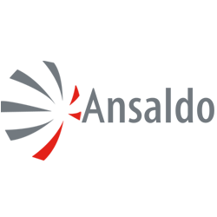


















A well-balanced sector distribution
20.4% H1 2016
20.2%
Aerospace
15.7%
Defence & Security
4.5%
Automotive
22.3%
23.4% H1 2016
25.1%
Rail/Naval
2.8%
14.8% H1 2016
14.0%
Multimedia
6.2%
€983.7M
Telecoms
7.8%
Energy
10.9%
23.1% H1 2016
22.4%
Life Sciences
6.9%
Other Industries
4.6%
18.3% H1 2016
18.3%
IT Services/Finance
18.3%
Notes:
No dependency on one business sector in particular

Slide 7




Our markets
Sustained growth in business with French/Swedish equipment
manufacturers.
Moderate growth in business with German automakers.
Projects focused on autonomous, emissions (Nox, Co2), “infotainment” and security.
Forecast for 2017: continued strong momentum
22.3%
Automotive
Improved business in rail and naval sectors.
Forecast for 2017: moderate growth
2.8%
Rail/Naval
New projects in manufacturing engineering, 4.0 Industry, digitalisation and embedded systems.
Strong growth in “launchers” activity in Space sector.
Forecast for 2017: continued growth
15.7%
Aerospace/
Space
Notes:
Aucune dépendance à un secteur d’activité en particulier

Slide 8



Our markets
Marked decline (≈20%) in Oil & Gas and Nuclear.
Continued growth (≈20%) in Pharmacy and Medical equipment.
Forecast for 2017: gradual stablization in Oil & Gas; continued growth in Life Sciences.
17.8%
Energy &
Life Sciences
Moderate decline in business with operators (outside France) and gradual recovery in business with equipment makers in Europe.
Forecast for 2017: very moderate growth in business.
7.8%
Telecoms
17,8%
Growth in business with the digitalisation of process and offer despite difficulties in recruitment.
Forecast for 2017: moderate growth in business.
18.3%
Tertiary/Services
Notes:
Aucune dépendance à un secteur d’activité en particulier

Slide 9
Continued growth strategy through acquisitions
Alten has completed six acquisitions abroad since the beginning of the year:
Two companies in Europe (Germany & Switzerland)
(turnover: €20M, 170 consultants)
Four companies in the US,
(turnover: €32M, 205 consultants).
Alten continues to expand internationally by deploying a
targeted external growth strategy.

Slide 10
Shareholding as at 12 September 2017
% in shares
Capitalisation (at 12/09/17):
€2,553M
Number of shares (at 12/09/17):
33 746 947
Public
82.93%
FCPE Alten
0.59%
Euronext Paris
Compartment A
FR 0000071946
(SRD)
Founder
15.11%
% of voting rights
Founder 26.17%
FCP 0.52%
Public 73.31%
Treasury stock
1.37%

Slide 11
2017 First Half Results
The procedures of limited examination of the half-yearly financial statements have been carried out. The limited
examination report will be issued after finalisation of the procedures required for the purpose of publication of the
half-yearly financial report.

Slide 12



Accelerated international growth
38.3
983.7
870.5
764.2
53.3%
51.4%
48.2%
443.4
36,0%
37,8%
30.7%
M
211.4
48.6%
46.7%
INT
22,0%
27.7%
51.8%
90.0
69.3%
22.0%
72.3%
FR
75.0%

Slide 13

Activity growth - GROUP
In €M
Revenue H1 2016
Revenue H1 2017
Change
Turnover on a like-for-like basis
870.5
932.5
+7.1%
Change in scope
52.9
+6.1 %
Exchange rate effect
-1.7
-0.20 %
GROUP TURNOVER
870.5
983.7
+13.0%
External growth accounts for 6.1% of total turnover, i.e. almost 50% of the Group’s consolidated growth in H1.

Slide 14
Activity growth - FRANCE
In €M
Revenue H1 2016
Revenue H1 2017
Change
Turnover on a like-for-like basis
422.8
447.4
+5.8%
Change in scope
12.0
+2.9%
France - TOTAL
422.8
459.4
+8.7%
Accelerated organic growth in France: (+6.7%) on a like-for-like basis

Slide 15
Activity growth - INTERNATIONAL
In €M
Revenue H1 2016
Revenue H1 2017
Change
Turnover on a like-for-like basis
447.7
485.1
+8.4%
Change in scope
40.9
+9.1%
Exchange rate effect
-1.7
-0.4%
International - TOTAL
447.7
524.3
+ 17.1%
Organic growth in international business remains strong (9.3% on a like-for-like basis)
External growth accounts for almost 50% of total growth.

Slide 16
Organic growth in first half 2017
As % | Q1 | Q2 | H1
France | 9.1% | 2.6% | 5.8%
International | 12.3% | 4.8% | 8.4%
GROUP | 10.7% | 3.7% | 7.1%
Restated for number of business days as compared to 2016 (+2 days in Q1; -3 days in Q2) and Forex, organic growth would reach 8% on a like-for-like basis in H1 2017.

Slide 17
Consolidated turnover by geographic region
(In €M)
 | YTD |  |  |  | Change
Country | H1 2016 | % | H1 2017 | % | Change | of which organic. and exchange rates effect
France | 422.8 | 48.6% | 459.4 | 46.7% | 8.7% | 5.8%
International | 447.7 | 51.4% | 524.3 | 53.3% | 17.1% | 8.4%
Germany | 83.8 | 9.6% | 103.9 | 10.6% | 24.0% | 6.3%
North America | 73.3 | 8.4% | 102.6 | 10.4% | 40.0% | 11.2%
Scandinavia | 70.0 | 8.0% | 80.1 | 8.1% | 14.4% | 17.3%
Spain | 42.5 | 4.9% | 45.7 | 4.6% | 7.5% | 7.5%
United Kingdom | 47.4 | 5.4% | 40.2 | 4.1% | -15.2% | -11.0%
Italy | 37.2 | 4.3% | 38.5 | 3.9% | 3.7% | 3.7%
Belgium | 31.1 | 3.6% | 32.9 | 3.3% | 5.6% | 5.6%
Netherlands | 26.7 | 3.1% | 29.0 | 2.9% | 8.6% | 8.6%
Asia-Pacific | 10.8 | 1.2% | 18.8 | 1.9% | 74.1% | 45.9%
Others | 24.8 | 4.1% | 32.5 | 3.3% | 31.0% | 13.7%
TOTAL | 870.5 | 100.0% | 983.7 | 100.0% | 13.0% | 7.1%

Slide 18
Condensed income statement
In €M | H1 2016 | H1 2017 | ^{Change} ^{2016/2017 %}
Turnover | 870.5 | 983.7 | +13.0%
Operating Profit on Activity As % of turnover | 88.5 10.2% | 92.6 9.4% | +4.6%
Share-based payment | - | - 10.0
Non-recurring profit | -1.6 | -0.5
Operating profit As % of turnover | 86.9 10.0 % | 82.1 8.3 % | -5.5%
Financial profit | -2.6 | 18.3
Corporate income tax EMCs and minority interests | -25.8 2.4 | -28.5 1.4
Net profit, Group share As % of turnover | 60.9 7.0 % | 73.3 7.5 % | +20.4 %
Operating margin mainly impacted by fewer business days in H1 2017 than H1 2016.

Slide 19
Analysis of financial profit
 | H1 2016 | H1 2017
Borrowing costs | -0.5 | -0.4
Foreign exchange risk | -2.1 | -2.7
Others financial results | - | 21.4
Financial profit | -2.6 | 18.3
*
(*) included the capital gain on disposal of Ausy shares: €21.5M

Slide 20
Condensed income statement by region
In €M | H1 2016 France | H1 2016 Intrnl | H1 2016 Group |  | H1 2017 France | H1 2017 Intrnl | H1 2017 Group
Turnover | 422.8 | 447.7 | 870.5 |  | 459.4 | 524.3 | 983.7
Operating profit on activity As % of turnover | 46.3 11.0% | 42.1 9.4% | 88.5 10.2% |  | 46.8 10.2% | 45.8 8.7% | 92.6 9.4%
Share-based payments | - | - | , |  | -10.0 | - | -10.0
Non-recurring profit | -0.5 | -1.1 | -1.6 |  | 0.1 | -0.6 | -0.5
Operating profit As % of turnover | 45.9 10.8% | 41.0 9.2% | 86.9 10.0% |  | 36.9 8.0% | 45.2 8.6% | 82.1 8.3%
Financial profit | -0.4 | -2.2 | -2.6 |  | 17.8 | 0.5 | 18.3
Corporate income tax EMCs and minority interests | -14.8 2.3 | -11.0 0.1 | -25.8 2.4 |  | -16.0 1.7 | -12.5 -0.3 | -28.5 1.4
Net profit, Group share As % of turnover | 33.0 7.8% | 27.8 6.2% | 60.9 7.0% |  | 40.4 8.8% | 32.9 6.3% | 73.3 7.5%

Slide 21
A solid financial structure
ASSETS (in €M)
EQUITIES & LIABILITIES (in €M)
Dec. 2016
June 2017
Dec. 2016
June 2017
NON-CURRENT ASSETS:
552.3
goodwill: 411.2
NON-CURRENT ASSETS:
526.9
goodwill: 412.5
SHAREHOLDERS’ EQUITY:
739.1
Group share: 738.7
SHAREHOLDERS’ EQUITY:
761.7
Group share:
760.9
CURRENT ASSETS:
681.7
customer receivables: 579.2
CURRENT ASSETS:
729.4
customer receivables: 612.0
NC LIABILITIES: 53.0
NC LIABILITIES: 51.9
CURRENT LIABILITIES:
455.9
CURRENT LIABILITIES:
454.8
Cash position: 95.0
Cash position: 83.1
Financial liabilities: 81.0
Financial liabilities: 71.0
Total: 1,329.0
Total: 1,339.4
Total: 1,329.0
Total : 1,339.4
No financial debt, gearing of -0.37%

Slide 22
Change in net cash positions – H1 2017 (In €M)
Free cash flow : +18.6
-24.5
94.4
-46.3
17,4
-5
13.5
17,4
-33.2
4.6
-0.7
2.8
Net cash 31/12/2016
Cash-flow
Tax paid
Change in WCR
Capex
Financial Investment
Dividends
Other financing flows
Net cash 30/06/2017

Slide 23
Analysis of free cash flow
H1 2016
H1 2017
6 months
H1 2017
12 months
CASH FLOW
As % of turnover
91.5
10.5%
94.4
9.6%
188.6
10.1%
Taxes paid
(23.6)
(24.5)
(53.2)
Change in WCR
(56.8)
(46.3)
(10.4)
Cash flow from operations
As % of turnover
11.1
1.3%
23.6
2.4%
125.0
6.7%
Capex
(5.3)
(5.0)
(13.5) ⁽*⁾
Free Cash Flow
5.8
18.6
111.5 ⁽*⁾
⁽*^{) economic data}

Slide 24
Analysis of free cash flow
  Cash flow is up and consistent with the increase in Operating Profit on Activity.
  Working capital requirements are satisfactory and accounted for:
  Financing organic growth,
  A contained seasonal increase in DSO between December 2016
  (94 days) and June 2017 (95.5 days). As a reminder, DSO was 98 days in June 2016.
  Capital expenditures remain low at 0.5% of turnover.

Slide 25
Summary
  ALTEN achieved a satisfactory organic growth in the first half of 2017, both in France and overseas.
  The operating margin on activity is mainly impacted by seasonal calendar effects (60 bp).
  Free cash flow grows significantly; on a sliding 12-month period it has reached notional levels, i.e. 6.5% of turnover with an operating profit on activity of 10% on a like-for-like basis.
  The Group has self-financed its organic growth, external growth and dividend payments.

Slide 26
Growth strategy

Slide 27
Strategy for the next three years
Remain focused on high added value engineering skills:
  Alten Core business 80% in Studies – Conception - Engineering
  Solutions 20% complementary offers, training, Customer support etc.
Deploy our organization (technical, managerial and HR) to all countries:
To capitalize on our expertise and offers to provide our clients with an unbeatable added value.
To reach a critical size - above 2,000 P by country - to fulfill the requirements for globalization and transformation.
Our goals for 2017 - 2019:
To gain a significant market position in Eastern Europe, Germany, North America, China.
To follow on and complete the transformation of our activities in Germany (Technical Management/workpackage) and reach the critical size of all OEMs to restore an operating margin (>10%).

Slide 28
The growth outlook
1989 – 2000
2001 – 2015
2016 – 2019
Acquisitions > 4,500
+
>21,500
Acquisitions +4,000
> 3,500
+
Organic
14,000
18,000
+ 11 000
Organic
3,000
3,000
33% external growth
50% external growth
TOTAL 3,000
TOTAL 18,000
TOTAL > 26,000
→ The 3 keys to grow: - Recruitment
- Project control
- Targeted acquisitions
Notes:
2145 end-1999
3000 end-2000

Slide 29

Conclusion
The internationalisation process is efficiently pursued (60% of turnover is expected at the end of 2019) thanks to a maintained organic growth and targeted acquisitions.
Intensive deployment of a structure that will suit the issues and challenges of our clients:
A reference managerial and HR organization;
An international Technical Direction with delivery centres and well-structured skills centres.
ALTEN has reassessed the goals of its growth strategic plan for 2017 – 2019 and remains strictly positioned on its business model.
ALTEN aims 26,000 engineers at the end of 2019 (vs. 25,000 at the end of 2016).
Notes:
2145 end-1999
3000 end-2000

Slide 30
APPENDICES

Slide 31
Balance sheet – assets (in thousand of euros)

Slide 32
Balance sheet – liabilities (in thousand of euros)

Slide 33
Income statement (in thousand of euros)

Slide 34
Cash flow statement (in thousand of euros)

Slide 35
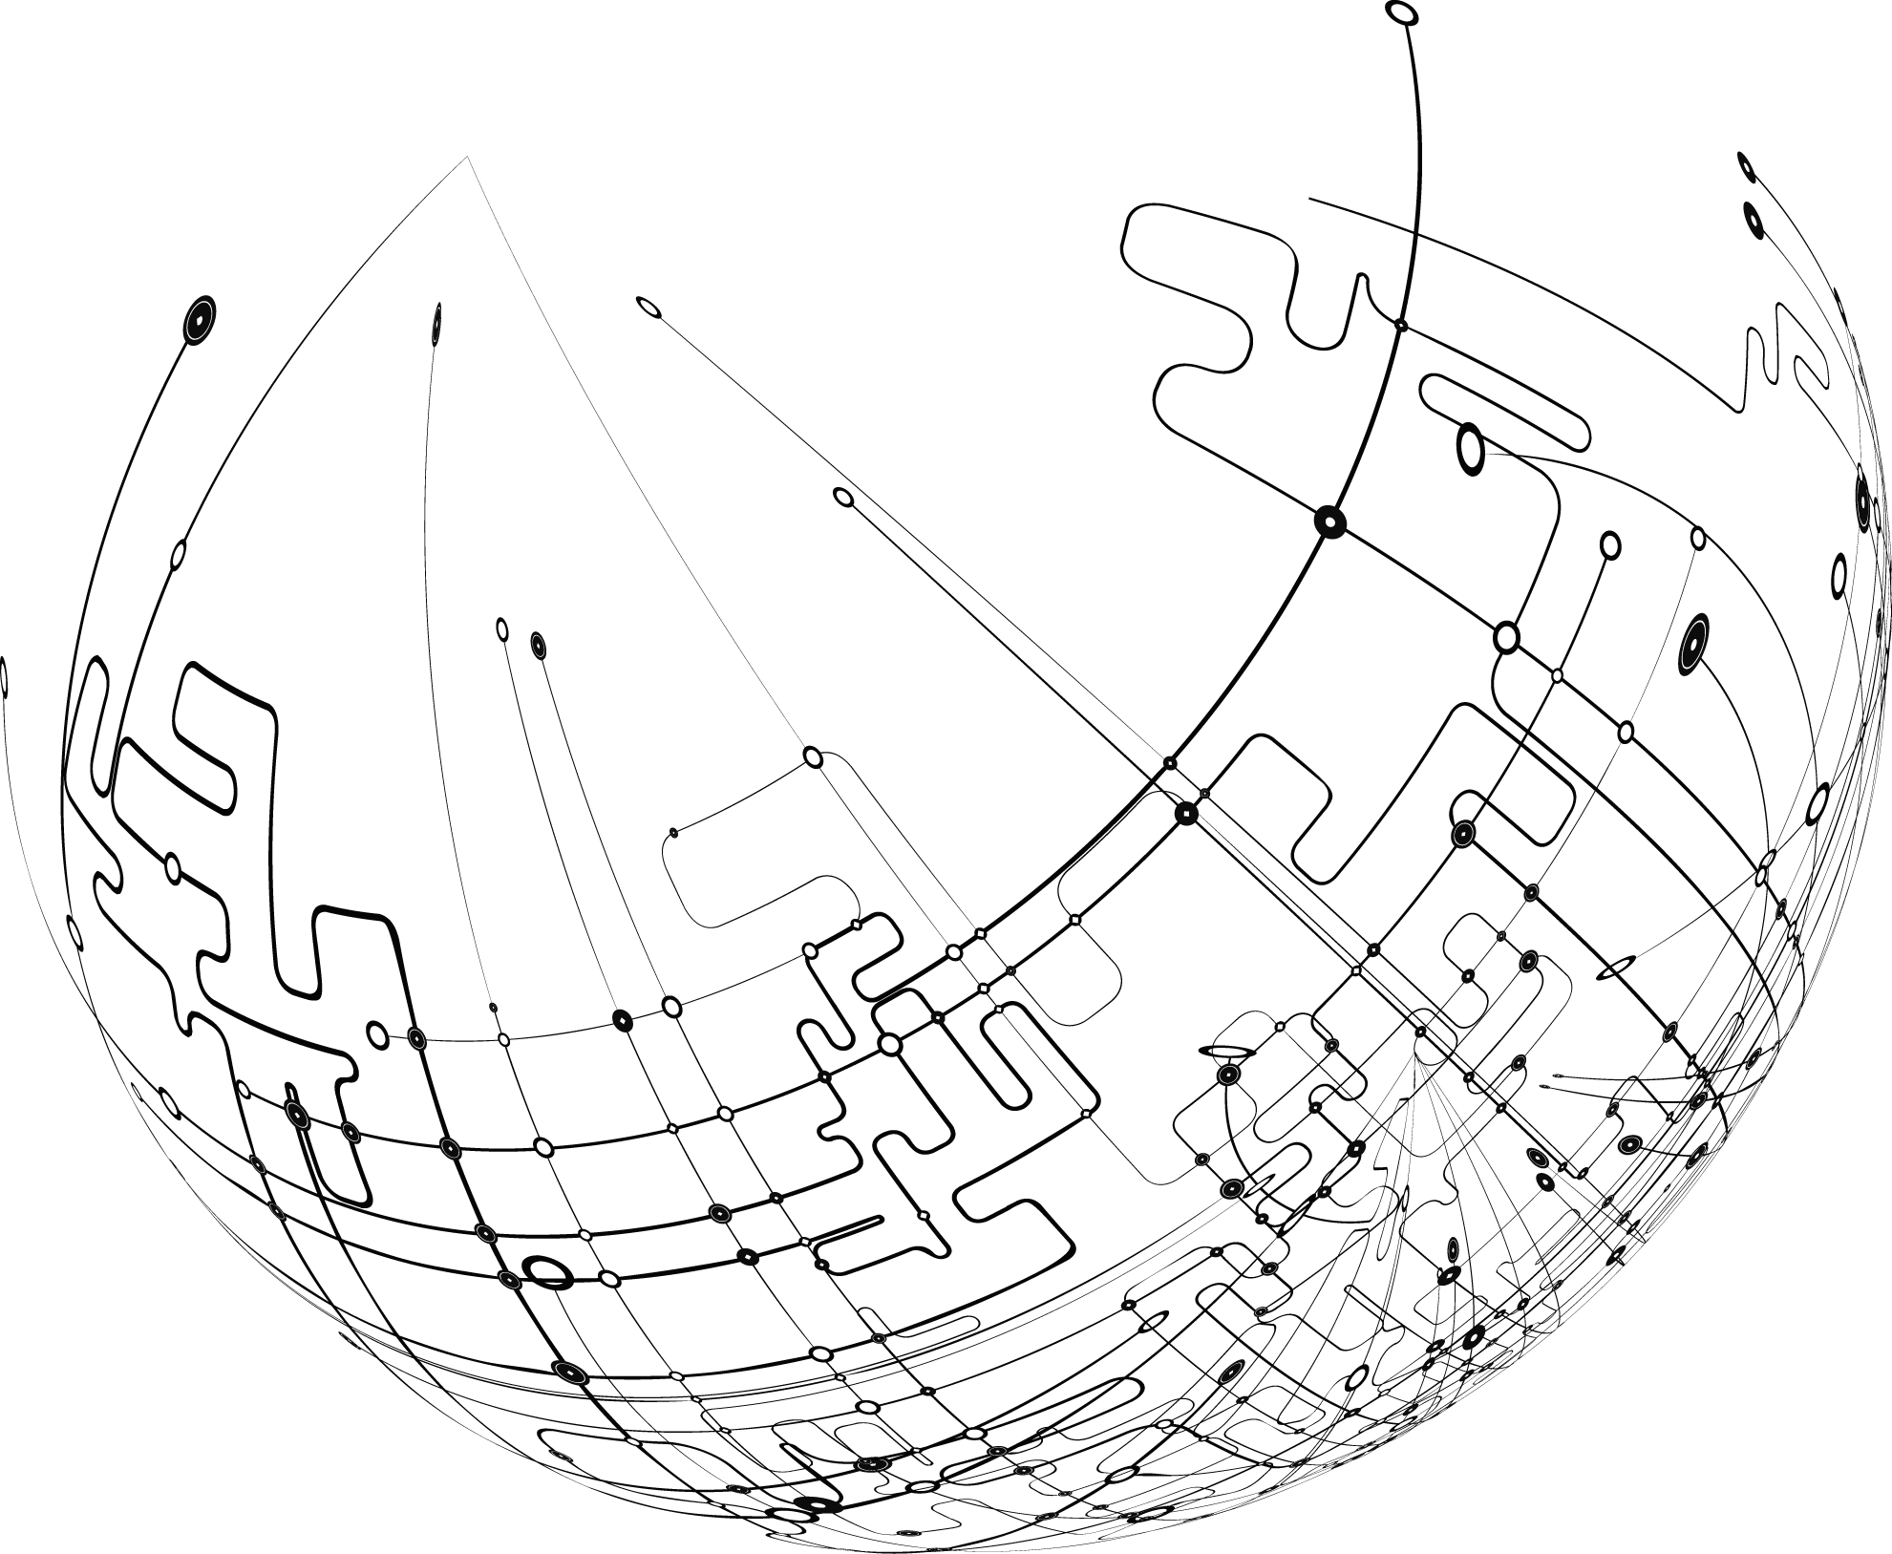
ALTEN
2017 first half results
Contact
comfi@alten.fr
www.alten.fr/investisseurs
T : +33 (0)1.46.08.71.79
40 av. André Morizet
92513 Boulogne-Billancourt Cedex

